Slide 1

AI and Machine Learning for IoT Big Data

Slide 2
Case study 1: WSN

Slide 3
Outline of the lecture
Wireless Sensor Networks (WSN) are one of the most important IoT foundational technologies. After reviewing some background basics, we will consider sample cases of using WSN for different practical tasks.
We will then follow through a published example of analyzing WSN data for anomaly detection in a Smart City application.

Slide 4
Where are we in the Course?
Introduction: Background of IoT, Big Data, AI
Collect, analyze data from IoT on a large scale
Elements and practice of statistics
AI methods for data science
Getting further with AI: internal workings
Practical usage of AI for Big Data from IoT
Moving into the real world

Slide 5
Wireless Sensor Networks (WSN)
A short review of Wireless Sensor Networks
Anomaly detection in WSN
Security issues
Algorithmic approaches
Clustering approaches
Real-time query processing with Deep Learning

Slide 6
WSN concepts
Spatially distributed sensors (temperature etc.)
Wireless connections:
WIFI (short-medium range)
Bluetooth, BLE (short range)
LoRa, SIGFOX, Zigbee (mid-long range)
Mobile network (long-range)
Streaming data, often low bandwidth
Data protocols, e.g. MQTT

Slide 7
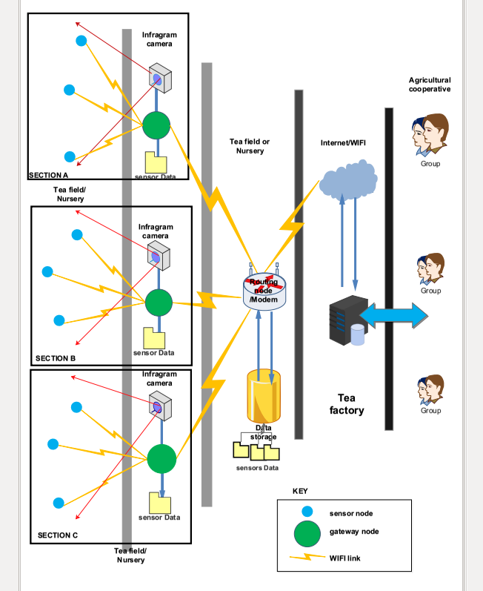
Example of a WSN: tea field monitoring in Rwanda
Environmental data collected by sensor nodes
Data routed to the Internet and aggregated in the cloud
Notes:
Refer to the paper:
Tech4Dev 2016, Lausanne, Switzerland,
Poster [IC05] Raymond Ndacyayisaba, Kobe Institute of Computing, Japan,
“Wireless Sensor Networks for Tea Farm Monitoring in Rwanda”

Slide 8
A solar-powered WSN node
Credit: https://upload.wikimedia.org/wikipedia/commons/4/48/CSIRO_ScienceImage_3876_A_remote_sensing_node_part_of_CSIROs_Fleck_wireless_sensor_network_technology.jpg
Notes:
Explain the role of the typical solar powered WSN node components:
sensors (e.g. temperature, humidity, barometric pressure, light intensity etc.)
wireless communication (e.g.
control unit (CPU+memory controlling the sensors and communication)
solar panel (photovoltaic cells)
battery (to operate when the sun is down)
power control unit (charging control, output regulator)

Slide 9
Other common uses of WSN
Smart city: utilities (e.g. water leakage monitoring), traffic, environment etc.
Intelligent buildings
Health care (e.g. mobile monitoring)
Smart grid
Transport, tracking
Scientific sensing
Notes:
We find many examples on Libelium.
The following slides are taken from there.
Lecturers should add other examples relevant to their main topics.

Slide 10
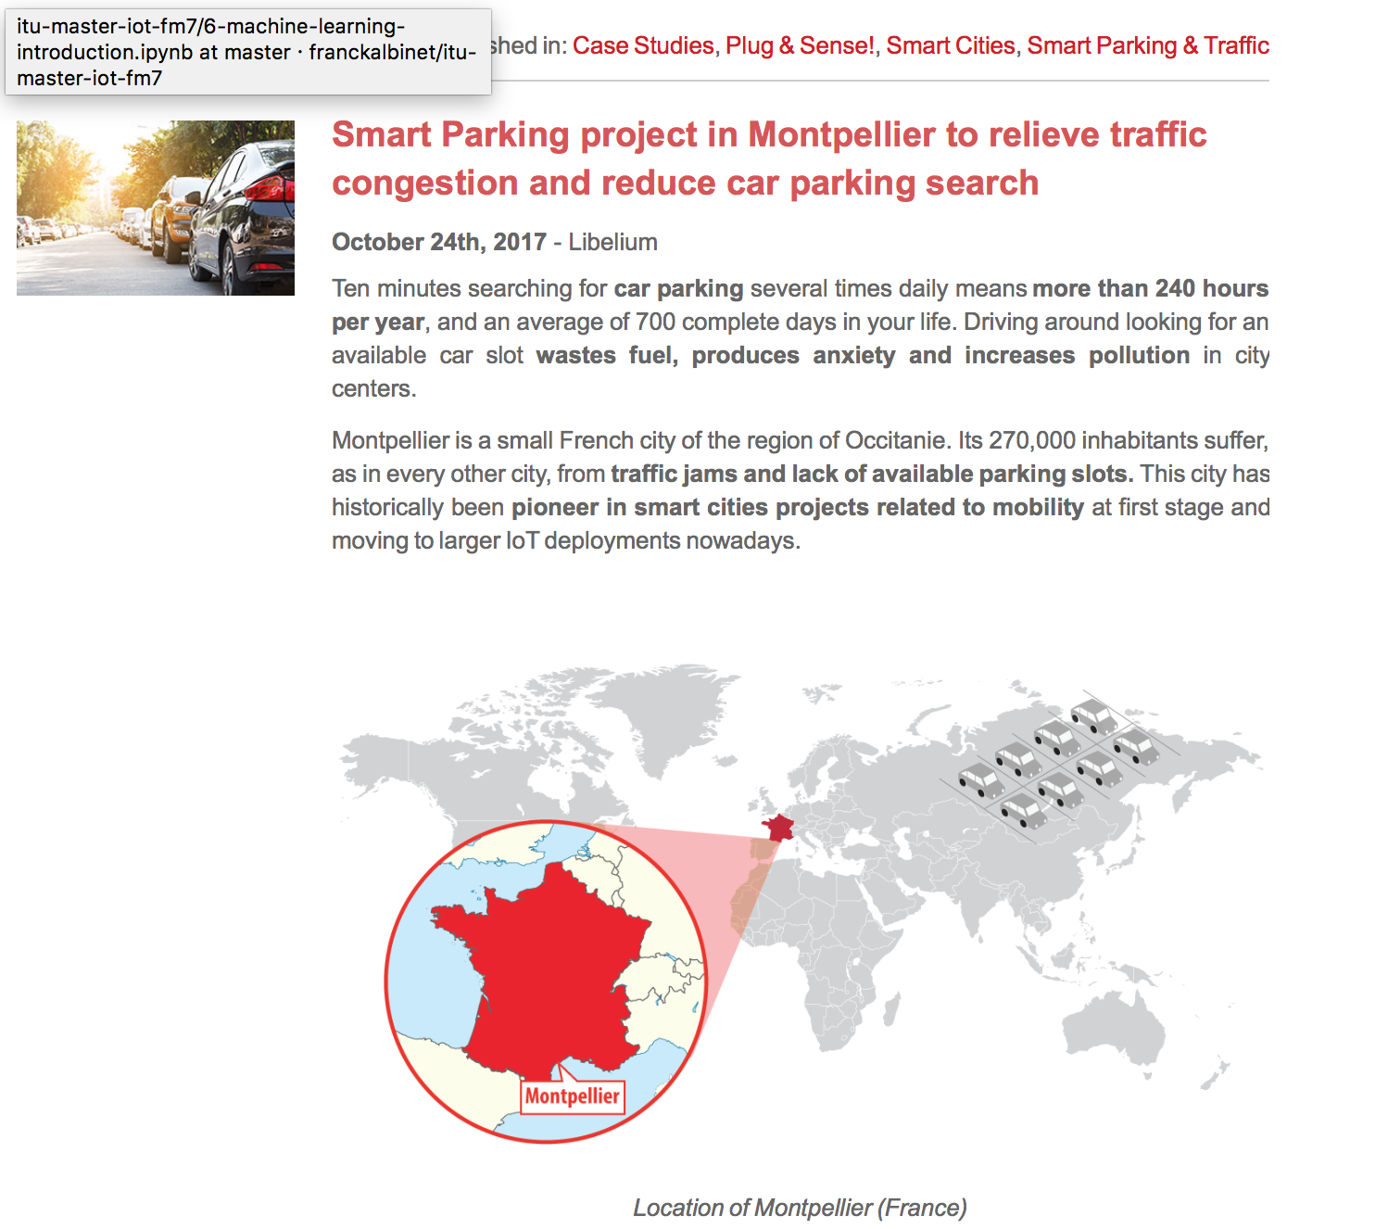
Example: smart parking for smart city
http://www.libelium.com/smart-parking-project-in-montpellier-to-relieve-traffic-congestion-and-reduce-car-parking-search/
Notes:
Discuss IoT applications for Smart City (transport, energy, pollution, security etc.)

Slide 11

Example: smart winery for smart agriculture
http://www.libelium.com/smart-wine-libeliums-iot-technology-allows-predictive-control-of-vineyards-in-the-pago-ayles-winery-spain/
Notes:
Discuss IoT applications for agriculture (monitoring, irrigation control, pest control etc.)

Slide 12

Example: water control with IoT
http://www.libelium.com/controlling-quality-of-irrigation-water-with-iot-to-improve-crops-production/
Notes:
Discuss IoT applications for water quality

Slide 13

WSN anomaly detection
A Comparative Study of Anomaly Detection Techniques for Smart City Wireless Sensor Networks
Victor Garcia-Font *, Carles Garrigues and Helena Rifà-Pous
http://www.mdpi.com/1424-8220/16/6/868
Security issues with smart city WSN
Attack detection: find anomalies
Real-world experiment is difficult
Method: detect simulated anomalies
Notes:
A published example of WSN data analysis

Slide 14
Anomaly Detection Methods
Extreme values in Mahalanobis Distance
Local Outlier Factor
Hierarchical Clustering
Classification with Support Vector Machines One-class Support Vector Machines (OC-SVM): Semi-supervised learning with Radial Basis Function (RBF) kernel
Notes:
Explain Mahalonobis distance, difference from Euclidean distance

Slide 15
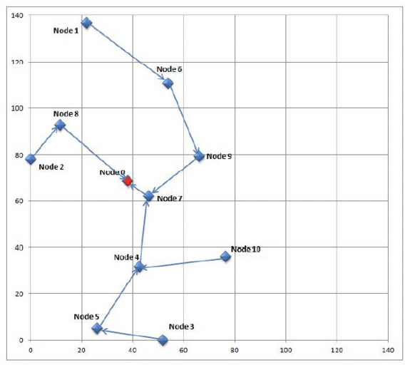
Simulated Smart City WSN
Sound streams collected at 10 locations are reproduced in simulation
http://www.mdpi.com/1424-8220/16/6/868
Notes:
How would a WSN be deployed in reality?

Slide 16
Feature Selection
Feature Vector 1 (FV1) : number of application packets, hour of the day
Feature Vector 2 (FV2) : FV1 fields, sequence number, battery level, lost packets, consumed energy
Feature Vector 3 (FV3) : FV2 fields, WSN link quality, received MAC ACK and CTS
http://www.mdpi.com/1424-8220/16/6/868
Notes:
Discussion based on the paper.

Slide 17
Flow of analysis
The anomaly analysis comprises three basic sub-steps for each of the compared techniques: the training, the validation and the test phases.
…The filtered dataset … [is] divided … in Figure. …The attack samples are not included in the training dataset (a), because the detection techniques … are semi-supervised or unsupervised.
… The validation and test datasets … divided into 8 additional datasets ((b) to (i) in the figure), resulting in a total of 17 datasets (16 + 1 training dataset).
http://www.mdpi.com/1424-8220/16/6/868
Notes:
Discussion based on the paper.

Slide 18
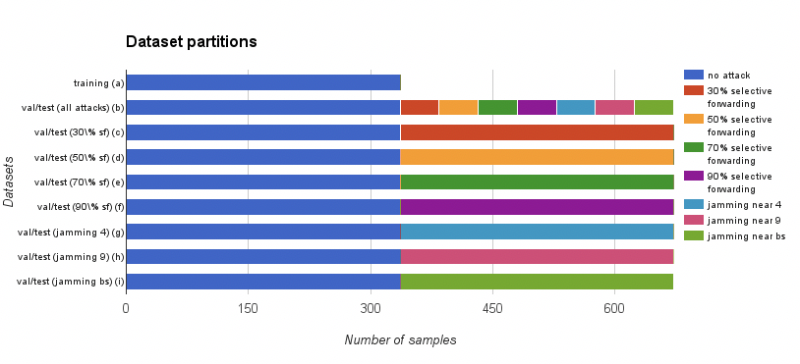
Simulated datasets for training the classifier
http://www.mdpi.com/1424-8220/16/6/868
Notes:
Discussion based on the paper.

Slide 19
Training phase
…Normalize and standardize the features in all the datasets (i.e., subtracting the mean and dividing by the standard deviation for each feature), … identify the features that have a zero variance in the training dataset, … removed from the three datasets (i.e., training, validation and test)
… Three different levels of false positive rate: permissive (false positive rate < 15%), restrictive (false positive rate < 10%) and very restrictive (false positive rate < 5%).
http://www.mdpi.com/1424-8220/16/6/868
Notes:
Discussion based on the paper.

Slide 20
Validation and test phase
The validation and test datasets are used to evaluate the performance of the algorithms in 72 experiments: (1 with all the attacks together + 7 with each attack separately) x 3 feature vector definitions x 3 PFPR levels.
..Use the detection algorithms to decide whether each sample has to be considered as an attack or not, …
count the correct identifications of attacks as true positives, the incorrect identifications of attacks as false positives, the correct identifications of no attacks as true negatives and the incorrect identifications of no attacks as false negatives.
http://www.mdpi.com/1424-8220/16/6/868
Notes:
Discussion based on the paper.

Slide 21
Results sorted by True Positive Rate (TPR)
OC-SVM dominates
http://www.mdpi.com/1424-8220/16/6/868
Notes:
Consider the labels given to each line.

Slide 22
Discussion
Compare the TPR (True Positive Rate) for the four methods
What is the reason for requiring low FPR (False Positive Rate)? What happens with many false positives?
Consider other anomaly situations; how to weight TPR vs. FPR? When would we allow many false alarms in return for finding all attacks?
Notes:
Assignment: analyze the original article, give critical comments

Slide 23
Summary of the lecture
We have reviewed a few samples of WSN applications, and found leads for further study.
We have also reviewed a published case study, where the researchers collected data for city-wide wireless connections, then applied a simulated data methodology to train an AI classifier to be used as an anomaly detector.

